Slide 1

LEARN PROGRAMMING WITH
KELVIN
kelvindsmn@gmail.com

Slide 2
MATERIAL
In this course we will learn about the following concepts :
Nested Conditional

Slide 3
NESTED CONDITIONAL STRUCTURE
if condition:
if condition:
block
else:
block
else:
block

Slide 4
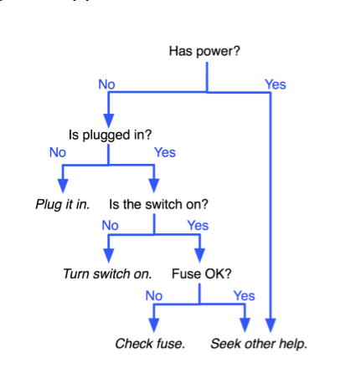
EXERCISE
Create a program based on the picture, using nested if

